Slide 1
Lecture 10 - Control
Managing Business

Slide 2
Learning Outcomes
At the end of the lecture, you should be able to:
  Define control.
  Contrast the three approaches to designing control systems.
  Discuss the reasons why control is important.
  Explain the planning-controlling link.

Slide 3
What Is Control?
Controlling
  The process of monitoring activities to ensure that they are being accomplished as planned and of correcting any significant deviations.
The Purpose of Control
  To ensure that activities are completed in ways that lead to accomplishment of organisational goals.

Slide 4
Designing Control Systems
Market Control
  Emphasises the use of external market mechanisms to establish the standards used in the control system.
    External measures: price competition and relative market share
Bureaucratic Control
  Emphasises organisational authority and relies on rules, regulations, procedures, and policies.
Clan Control
  Regulates behavior by shared values, norms, traditions, rituals, and beliefs of the firm’s culture.

Slide 5
Characteristics of Three Approaches to Control Systems
Type of Control | Characteristics
Market | Uses external market mechanisms, such as price competition and relative market share, to establish standards used in system. Typically used by organisations whose products or services are clearly specified and distinct and that face considerable marketplace competition.
Bureaucratic | Emphasises organisational authority. Relies on administrative and hierarchical mechanisms, such as rules, regulations, procedures, policies, standardisation of activities, well-defined job descriptions, and budgets to ensure that employees exhibit appropriate behaviors and meet performance standards.
Clan | Regulates employee behavior by the shared values, norms, traditions, rituals, beliefs, and other aspects of the organisation’s culture. Often used by organisations in which teams are common and technology is changing rapidly.

Slide 6
Why Is Control Important?
As the final link in management functions:
  Planning
    Controls let managers know whether their goals and plans are on target and what future actions to take.
  Empowering employees
    Control systems provide managers with information and feedback on employee performance.
  Protecting the workplace
    Controls enhance physical security and help minimise workplace disruptions.

Slide 7
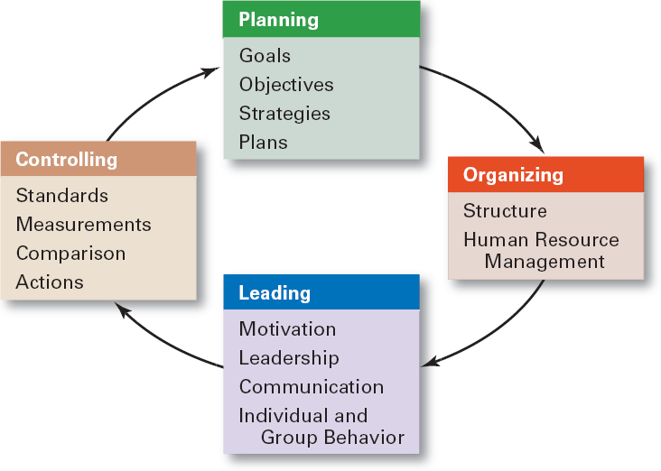
The Planning-Controlling Link

Slide 8

The Control Process
The Process of Control
  Measuring actual performance.
  Comparing actual performance against a standard.
  Taking action to correct deviations or inadequate standards.

Slide 9
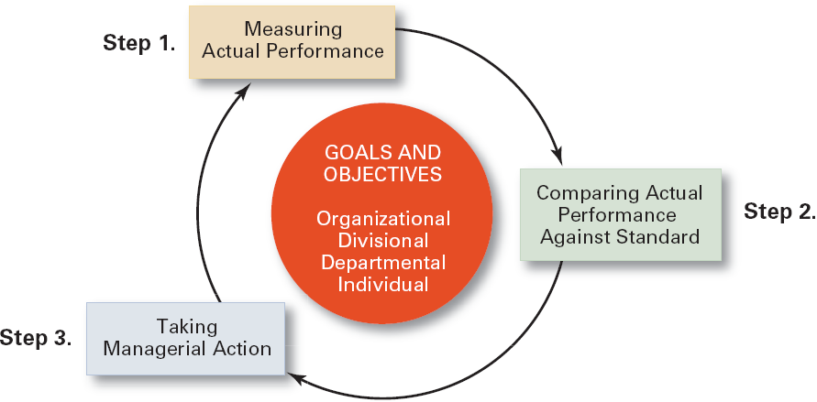
The Control Process

Slide 10
Measuring: How and What We Measure
Sources of Information (How)
  Personal observation
  Statistical reports
  Oral reports
  Written reports
Control Criteria (What)
  Employees
    Satisfaction
    Turnover
    Absenteeism
  Budgets
    Costs
    Output
    Sales

Slide 11
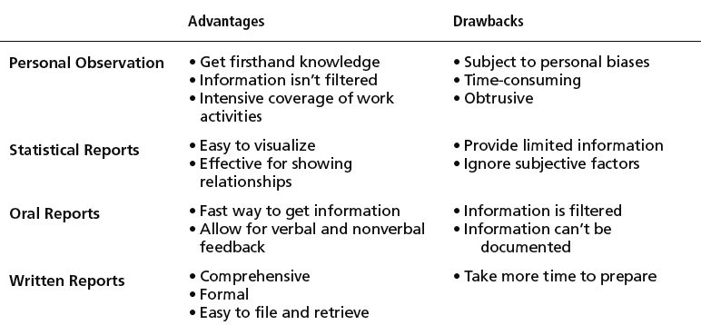
Common Sources of Information for Measuring Performance

Slide 12
Comparing
Determining the degree of variation between actual performance and the standard.
  Significance of variation is determined by:
    The acceptable range of variation from the standard (forecast or budget).
    The size (large or small) and direction (over or under) of the variation from the standard (forecast or budget).

Slide 13
Taking Managerial Action
Courses of Action
  “Doing nothing”
    Only if deviation is judged to be insignificant.
  Correcting actual (current) performance
    Immediate corrective action to correct the problem at once.
    Basic corrective action to locate and to correct the source of the deviation.
    Corrective Actions
      Change strategy, structure, compensation scheme, or training programs; redesign jobs; or fire employees

Slide 14
Taking Managerial Action (cont’d)
Courses of Action (cont’d)
  Revising the standard
    Examining the standard to ascertain whether or not the standard is realistic, fair, and achievable.
      Upholding the validity of the standard.
      Resetting goals that were initially set too low or too high.

Slide 15
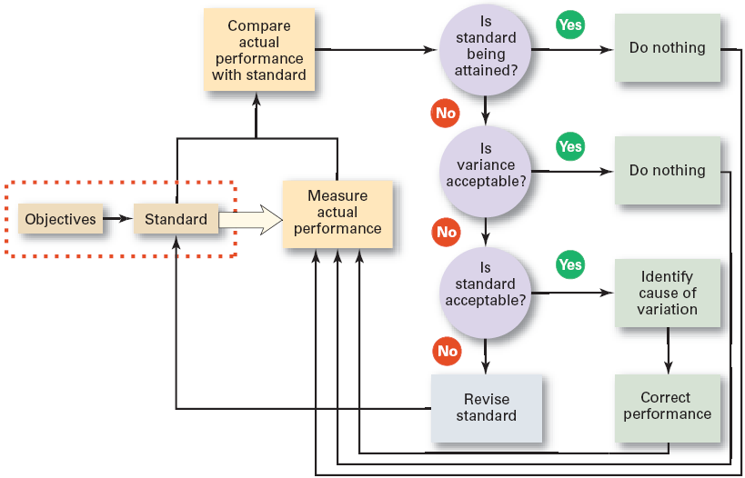
Managerial Decisions in the Control Process

Slide 16

Controlling for Organisational Performance
What Is Performance?
  The end result of an activity
What Is Organisational
Performance?
  The accumulated end results of all of the organisation’s work processes and activities
    Designing strategies, work processes, and work activities.
    Coordinating the work of employees.

Slide 17
Organisational Performance Measures
Organisational Productivity
  Productivity: the overall output of goods and/or services divided by the inputs needed to generate that output.
    Output: sales revenues
    Inputs: costs of resources (materials, labor expense, and facilities)
  Ultimately, productivity is a measure of how efficiently employees do their work.

Slide 18
Organisational Performance Measures
Organisational Effectiveness
  Measuring how appropriate organisational goals are and how well the organisation is achieving its goals.
    Systems resource model
      The ability of the organisation to exploit its environment in acquiring scarce and valued resources.
    The process model
      The efficiency of an organisation’s transformation process in converting inputs to outputs.
    The multiple constituencies model
      The effectiveness of the organisation in meeting each constituencies’ needs.

Slide 19
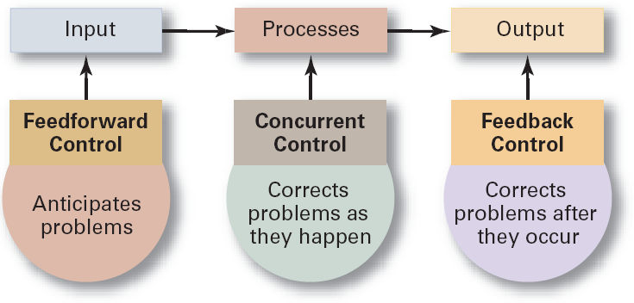
Types of Control

Slide 20
Tools for Controlling Organisational Performance
Feedforward Control
  A control that prevents anticipated problems before actual occurrences of the problem.
    Building in quality through design.
    Requiring suppliers conform to ISO 9002.
Concurrent Control
  A control that takes place while the monitored activity is in progress.
    Direct supervision: management by walking around.

Slide 21
Tools for Controlling Organisational Performance (cont’d)
Feedback Control
  A control that takes place after an activity is done.
    Corrective action is after-the-fact, when the problem has already occurred.
  Advantages of feedback controls:
    Provide managers with information on the effectiveness of their planning efforts.
    Enhance employee motivation by providing them with information on how well they are doing.

Slide 22
Summary of Main Teaching Points
  Describe the three steps in the control process.
  Explain why what is measured is more critical than how it’s measured.
  Explain the three courses of action managers can take in controlling.

Slide 23
Question and Answer Session
Q & A

Slide 24
Next Session
Topic and Structure of next session
NEXT LESSON:
Culture

